Slide 1

Wireless monitoring of the state of the electrical infrastructure

Slide 2


Slide 3
System objectives
• Never turn off your bus duct power system.
• The maintenance staff is not necessary.
• Extend the useful life of your bus duct power system.
• Save energy just using good practice.
• Detection of factors that will cause failures.

Slide 4
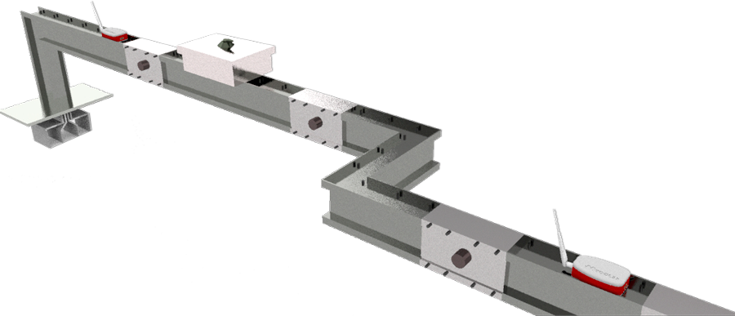
Easy to install and without turning off your busway system.

Slide 5
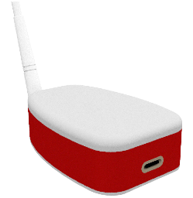

• To collect data surface, ambient and internal temperature, relative an surface humidity and impedance.
• Installation on busway surface.
• Plug and play.
• AI programmable alarms. (This alarms set off with respect to system behavior).
• Data transmission totally wireless. (Range until 8Km)
• Data transmission forming chains with any devices.
• Detection risk gradients with accuracy about 1m.
• Intuitive software, App or web plataform was designed to use in real time while installing the plug and play device or do you do a inspection tour.

Slide 6
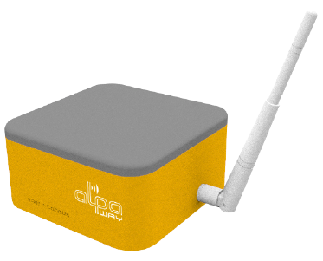
• To collect data voltage, currents, powers, pf, surface, ambient and internal temperature, relative an surface humidity.
• Installation on plug in box surface.
• The device requires installation of sensors inside the plug in box.
• User programmable alarms.
• AI programmable alarms. (This alarms set off with respect to system behavior.
• Data transmission totally wireless. (Range until 8Km)
• Data transmission forming chains with any devices.
• Detection risk gradients with accuracy about 1m.
• Intuitive software, App or web plataform was designed to use in real time while installing the plug and play device or do you do a inspection tour.

Slide 7
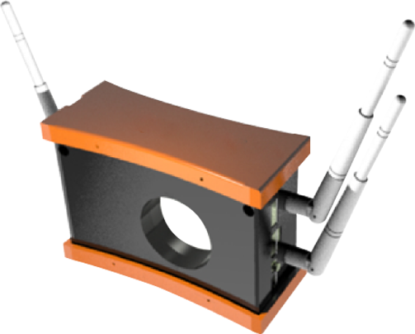
• This device is installed in control room.
• Data reception and transmission (24/7).
• User programmable alarms.
• Delivery information in data file, relationship graphics between any measurement variable collet.
• Data transmission totally wireless. (Range until 8Km)
• The system do not need wifi or internet network for its funtionability. (This device create its own data storage and information transfer system).
• Intuitive software, App or web plataform was designed to use in real time while installing the plug and play device or do yoy do a inspection tour.

Slide 8
AW1: This device (IP54) adheres to different sites of the Busway routes to monitor the chosen data 24/7 and sends the signal to Com1.

Slide 9
AW2: This device (IP54) is installed in the junction box and is the one that receives the measurements from all Com2, accumulates the data and sends it encrypted to the device designated by the client.

Slide 10
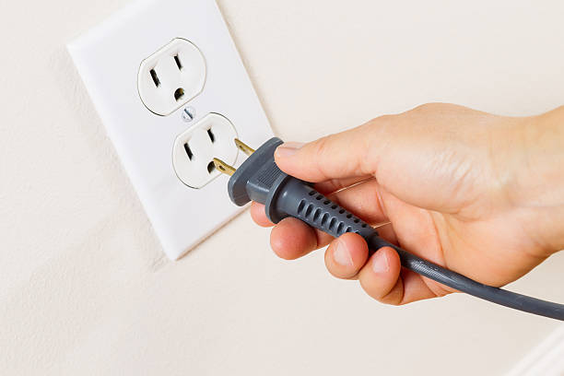

Slide 11

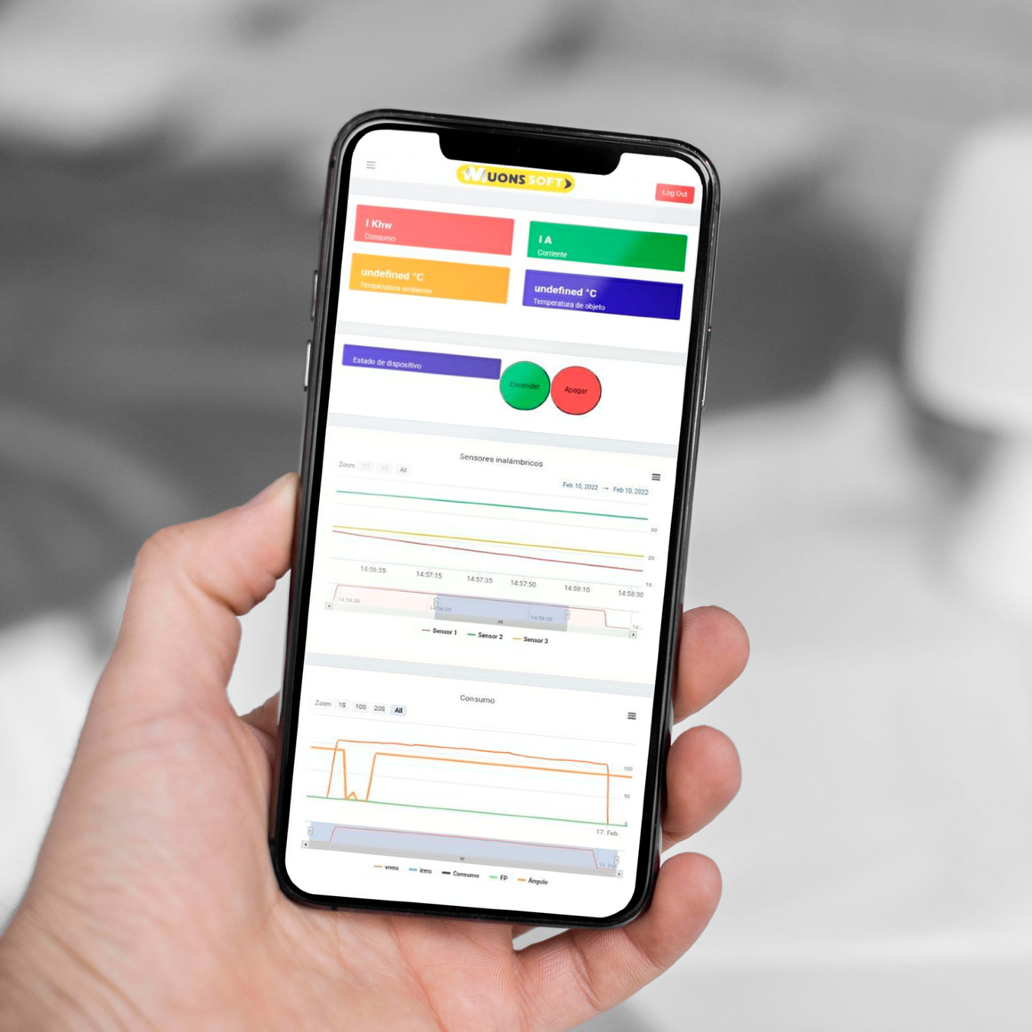
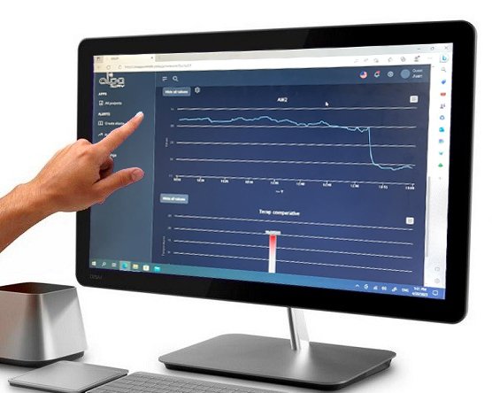
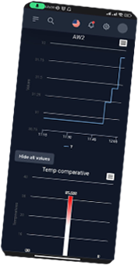
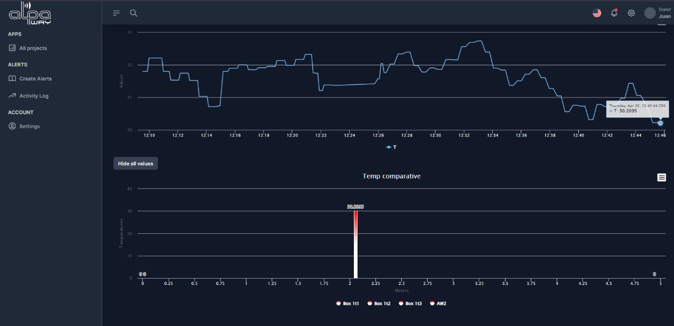
BMS

Slide 12
Diagnosis and
improvements for AI
Smart Busway monitoring 24/7 with AI
Encrypted data
transmission
Reforms and maintenance projection (0% manual intervention)
Instant measurements, electrical variables, flow, and temperature spectrum
Flexibility for
locate device

Slide 13
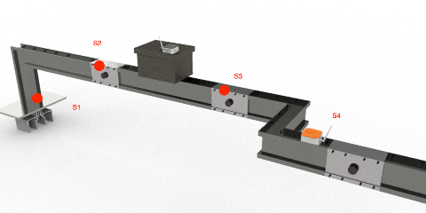
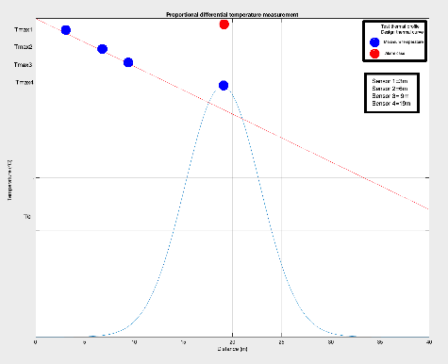
Example Test
Proportional differential temperature measurement. Comparison to temperature variations.
Detect abnormalities based on temperature variations between one measuring point on the other.
Example. An alarm will be set off when the temperature of a measuring point A is higher than the temperatures of four locations before and after A.

Slide 14
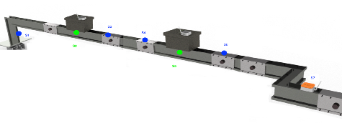
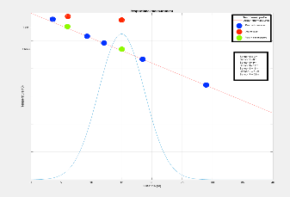
Example Test
Proportional measurement. Comparison to temperature differences.
For bus ducts with two or more stacks, an alarm will be set off if the temperature differences of the stacks are higher than the set value.

Slide 15
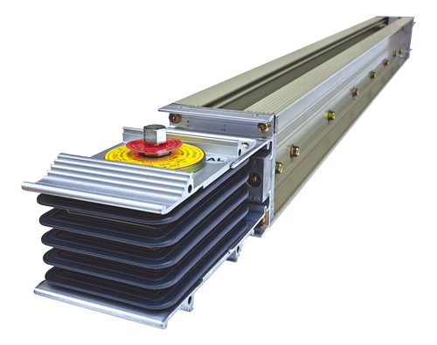
Carrera 32 #13-49 Edificio C13 - Of.308 · 604 322 99 84 · +57 311 340 3037 · Medellín · Colombia
info@alpaway.com – alpaway.com

Slide 16



Click to play video

Slide 17
Click to play video

Slide 18
Click to play video

Slide 19
Click to play video

Slide 20
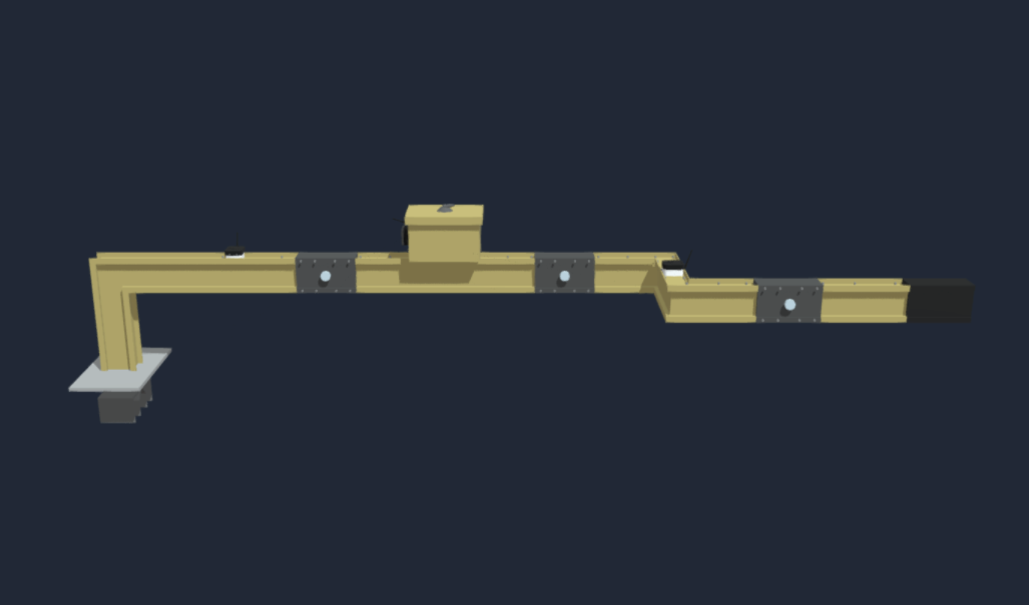
Click to link
https://sketchfab.com/models/33eb466836894ba4ae2a04989ba3687b/embed

Slide 21
Thanks

